Slide 1


Slide 2
SUMMARY
SECTION 1:
Description of the given problem
The identification of the actors
Our goals
SECTION 2:
Overall Description
SECTION 3:
External interface requirements
Functional requirements
The World and the Machine
Scenarios
UML Models
SECTION 4:
Alloy

Slide 3
SECTION 1
DESCRIPTION OF THE GIVEN PROBLEM
We will design and implement myTaxiService, a new web and mobile application to optimize the taxi service in big cities. It should simplify the access of passengers to the service and guarantee a fair management of taxi queues. The users will have to register and login in order to use the application, then they can request a taxi and be informed about the code of the incoming taxi and the waiting time.
We suppose the city is divided in zones and every one of them has a queue of available taxis present in the zone, whose position is calculated according to GPS. After a request arrives, the system informs the first taxi in the queue of
the zone from which the request came. If the taxi accept the request, the system sends the confirmation to the user. If not, the system will put it at the end of the queue and forward the request to the next available taxi. To accept ride requests, taxi drivers will have to login through the mobile app like normal users. Then they can set themselves as available and receive ride requests. A user can also reserve a taxi by inserting origin, destination and time of the ride. The request must be submitted at least two hours before. The system will allocate a taxi and notify the user 10 minutes before the ride.

Slide 4
SECTION 1
ACTORS:
Guest: the guests are users who are not registered yet. They must sign themselves up into the system in order to use the features available to registered users.
Registered user: this type of user, after successful login, has access to all the features of the application as a customer. They can request rides, be them simple or detailed, and receive notifications after a ride has been confirmed.
Driver: this type of user, after a successful login, can set himself as available and so can be notified when a new ride request arrives and, if he sees it, to accepts it.

Slide 5
SECTION 1
OUR GOALS:
We have divided the goals for every categories of actors we have identified.
Guests should be able to:
[G1] Register themselves into the system
[G2] Log themselves into the system
Users should be able to:
[G3] See number of available taxis of the zone they’re in
[G4] Make a request for a simple ride
[G5] Make a request for a detailed ride

Slide 6
SECTION 1
OUR GOALS:
Drivers should be able to:
[G6] Set themselves as available
[G7] Read and accept ride requests
The system should:
[G8] Notify passengers after the confirmation of a simple request
[G9] Notify passenger ten minutes before the ride reserved through a detailed
request
[G10] Forward request to the first taxi in queue
[G11] After 30 seconds, forward the request to the second taxi in queue and put
the first at the end

Slide 7
SECTION 2
OVERALL DESCRIPTION:
Product perspettive:
The application we will project is both a web application and a mobile application. It will not interact with any other existing application or system. It will be user based and we will not provide any internal interface for administration.
User characteristics:
People that will use our application are the ones interested in using the taxi service in the city. They will be able to request a taxi for a ride without any voice call but just with few clicks.

Slide 8
SECTION 2
OVERALL DESCRIPTION:
Assumptions:
When the app or the web page is closed the user automatically logs out.
If a driver sees a ride request, he always accepts it.
Users can't cancel ride requests.
If the system sends a notification the user will always receive it.
Users can make an unlimited number of daily ride requests.
In case of empty queue 10 minutes before a detailed ride, the application will always manage to find one within the time of the ride.
Users insert existing addresses when making requests.
The system knows if the credentials inserted during login belong to a user or a driver, so it will display the correct personal page afterwards.

Slide 9
SECTION 3
FUNCTIONAL REQUIREMENTS
[G1] Register themselves into the system
[R1] Guests can only see the login page.
[R2] Guests can only access to the registration form.
[D1] All the fields must be completed in a formal correct way.
[G2] Log into the system
[R1] Guests have to provide valid username a password in order to log themselves into the system.
[R2] The wrong insertion of one's own credentials will not allow to log himself into the system.
[G3] See number of available taxis of the zone he's in
[R1] The system has to visualize on the personal page the number of taxi available in the zone.

Slide 10
SECTION 3
FUNCTIONAL REQUIREMENTS
[G4] Make a request for a simple ride
[R1] Users have to insert the correct departure's address.
[D1] The inserted address has to be formed by a street and a civic number.
[G5] Make a request for a detailed ride
[R1] Users have to insert the correct departure's address.
[R2] Users have to insert the correct destination's address.
[R3] Users have to insert feasible date and time for the reservation.
[D1] The inserted address has to be formed by a street and a civic number.
[D2] Date must look like this: DD/MM/YY, and time like this: HH:MM.
[G6] Set themselves as available
[R1] The system has to provide a function through which drivers can inform it of their availability.
[R2] Once they're available, the system has to insert them into the Taxi Queue of their own zone.

Slide 11
SECTION 3
FUNCTIONAL REQUIREMENTS
[G7] Read and accept ride requests
[R1] The system has to provide a function to read and accept request
[G8] Notify passengers after the confirmation of a simple request
[R1] The system has to notify the user who made a simple request as soon as possible, this means as a taxi is available, informing him about the waiting time.
[G9] Notify passengers 10 minutes before the ride reserved through a detailed request
[R1] The system has to notify the user who reserved a taxi within ten minutes before the time of the ride.

Slide 12
SECTION 3
FUNCTIONAL REQUIREMENTS
[G10] Forward requests to the first taxi in queue
[R1] The system has to forward requests to the first taxi in queue allowing him to accept the request.
[R2] After a confirmation by a driver the system has to move the driver at the end of the queue and set him as not available.
[G11] After 30 seconds, forward the request to the second taxi in queue and put the first at the end
[R1] After a missed confirmation the system has to move the first driver in queue to the last position and forward the request to the second until one driver confirm the request.

Slide 13
SECTION 3
THE WORLD AND THE MACHINE

Slide 14
SECTION 3
SCENARIOS:
Scenario 1
Bob has planned to go to a workshop that will take place on the other side of Milan. He woke up early because he knows that there's always so much traffic in the city. Bob is ready to go with his car when the unexpected happens: the car seems broken. Without wasting any time he opens myTaxi app on his phone. He logs into the system and request a Taxi for a simple ride. John, already logged into the system as driver, sees the simple request on his phone and accepts it. The system immediately notifies Bob telling him John's taxi code and the relative waiting time. Bob has to attend just a few minutes because John's Taxi is only one kilometre away from him. Bob is happy because he will arrive on time despite the unexpected discovery of having his car broken.

Slide 15
SECTION 3
SCENARIOS:
Scenario 2
Bob, during the lunch break at the workshop, realizes that at the end of the event he doesn't have his car because he arrived in taxi. He also realizes that the end of the workshop is scheduled at 6p.m, critical time for traffic in the city with several waiting time for taxis. In order to this consideration, Bob opens myTaxi app and reserves a taxi for 6.15 p.m. to be sure that a taxi will be there at that moment. At 6.05 p.m. Bob's phone rings. A notification with the code of taxi that will arrive to him has just been received from his phone.

Slide 16
SECTION 3
SCENARIOS:
Scenario 3
It's 12a.m. and John, a taxi driver, decides to have a coffee break but he also decides to not log out from the app because he is the third in the Taxi Queue. He thinks he can drink a coffee and smoke a cigarette before he becomes the first of the Taxi Queue. . . but he is wrong. The other two driver that were in list before him log out from the system and John becomes the first in the Taxi Queue. A request arrives but Bob doesn't see it because he is still drinking his coffee. After 30 seconds John hasn't accepted yet and the system puts him into the last position forwarding the request to the second in list.

Slide 17
SECTION 3
SCENARIOS:
Scenario 4
Giuly decides to go to EXPO in the evening. She knows that the queue to enter is very long so she decides to go there at 5 pm in order to be in a good position when the gate will open. Giuly is scared to take the train to go there because she would be going back home alone. She decides to go there with a taxi and simply she opens myTaxi app and requests a taxi for a simple ride. Unfortunately, the system has detected that there is no one taxi available in her zone at the moment. Giuly immediately receives a notification that informs it of the problem inviting her to attend for the first available taxi.

Slide 18
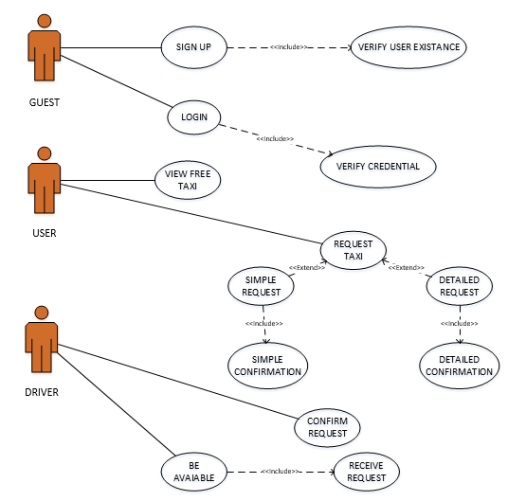
SECTION 3 – UML MODELS
USE CASE:

Slide 19
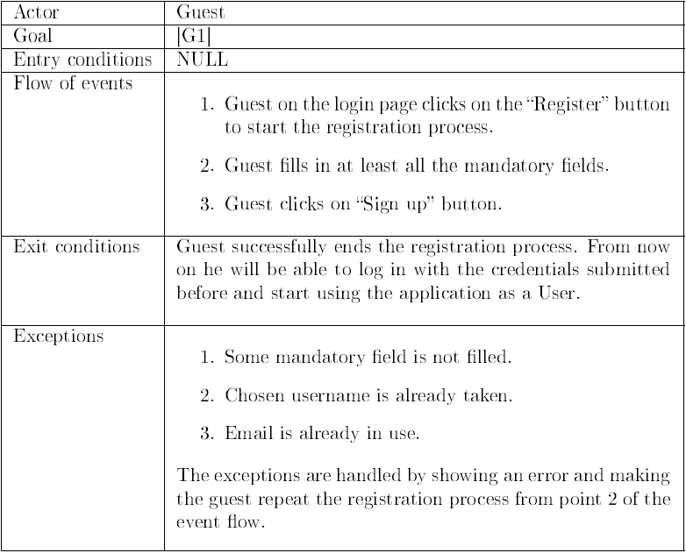
SECTION 3 – UML MODELS
SIGN UP:

Slide 20
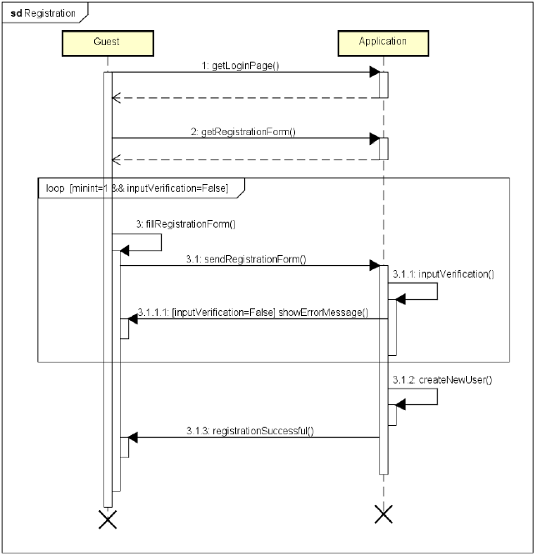
SECTION 3 – UML MODELS
SIGN UP:

Slide 21
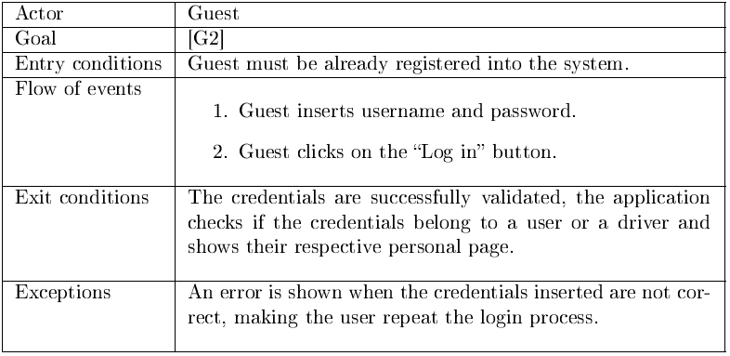
SECTION 3 – UML MODELS
LOG IN:

Slide 22
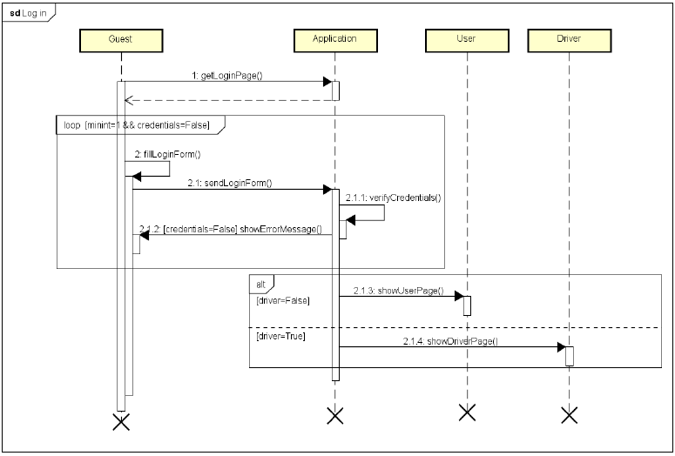
SECTION 3 – UML MODELS
LOG IN:

Slide 23
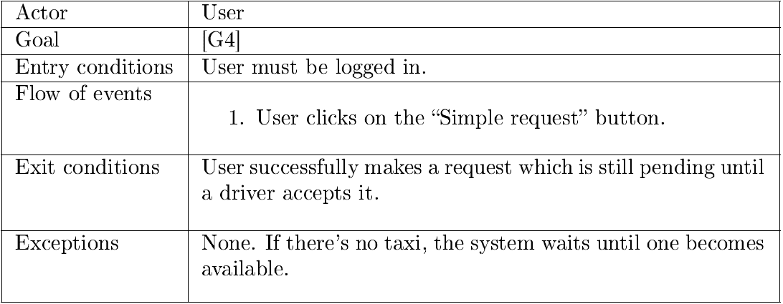
SECTION 3 – UML MODELS
MAKE SIMPLE REQUEST:

Slide 24
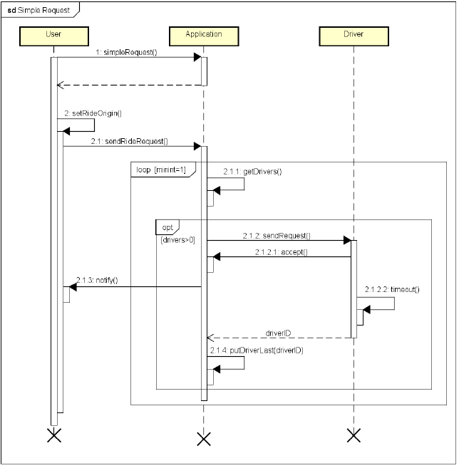
SECTION 3 – UML MODELS
MAKE SIMPLE REQUEST:

Slide 25
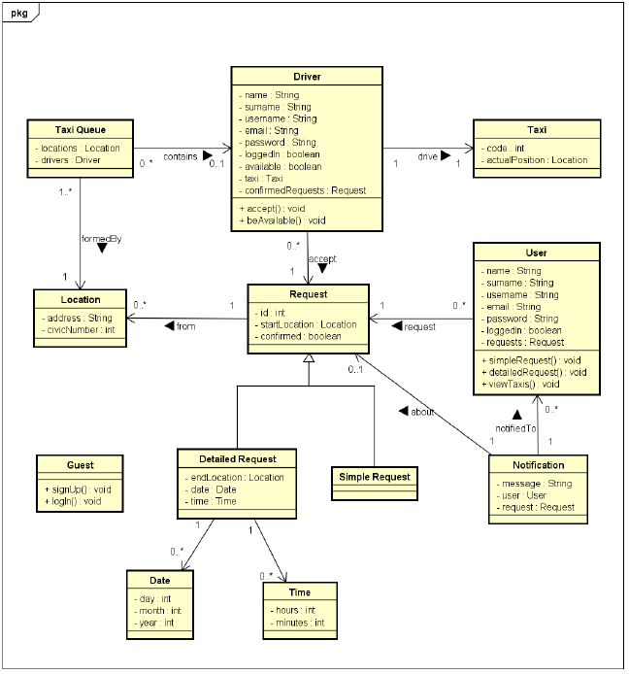
SECTION 3
UML MODELS
CLASS DIAGRAM:

Slide 26
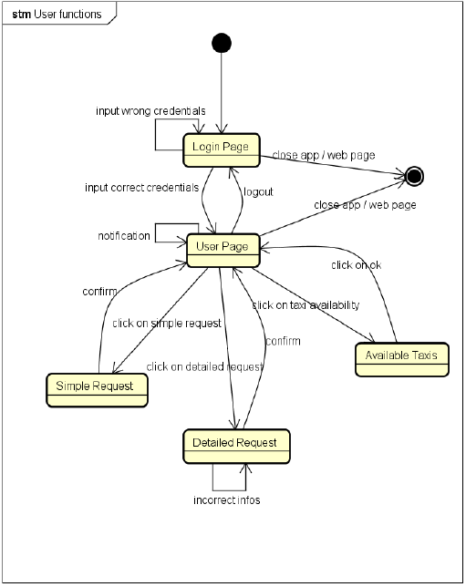
SECTION 3
UML MODELS
STATE MACHINE DIAGRAM
USER FUNCTIONS:

Slide 27
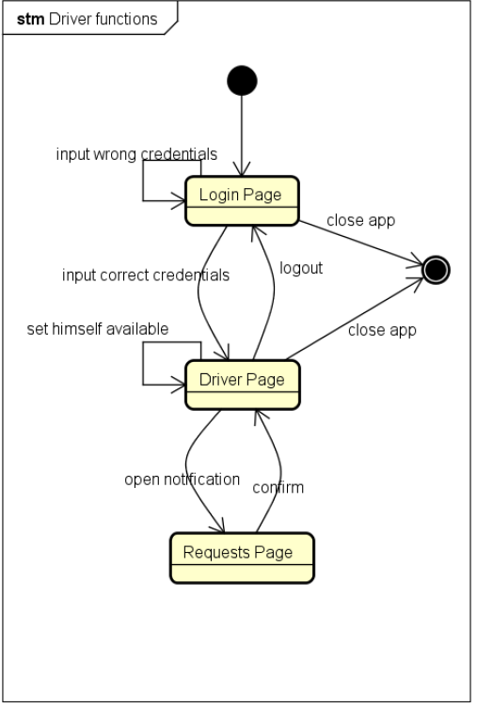
SECTION 3
UML MODELS
STATE MACHINE DIAGRAM
DRIVER FUNCTIONS:

Slide 28
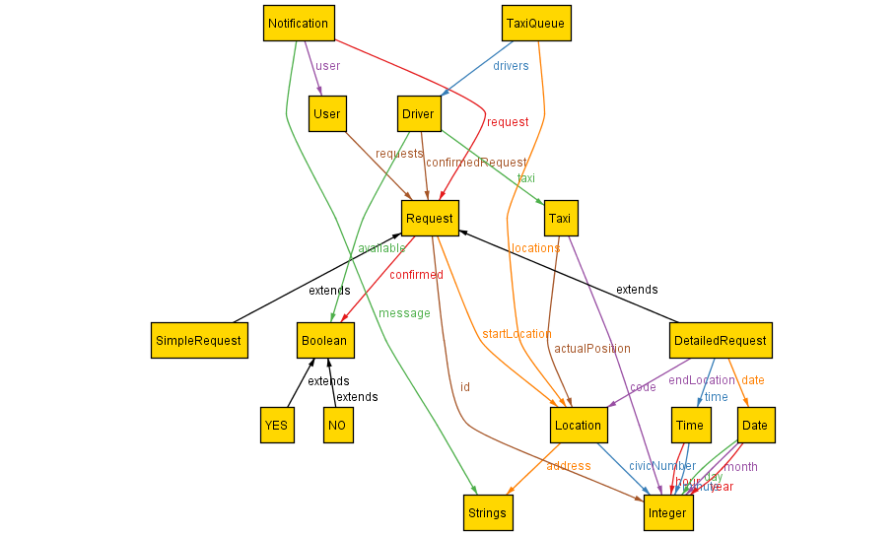
SECTION 4
ALLOY METAMODEL:

Slide 29
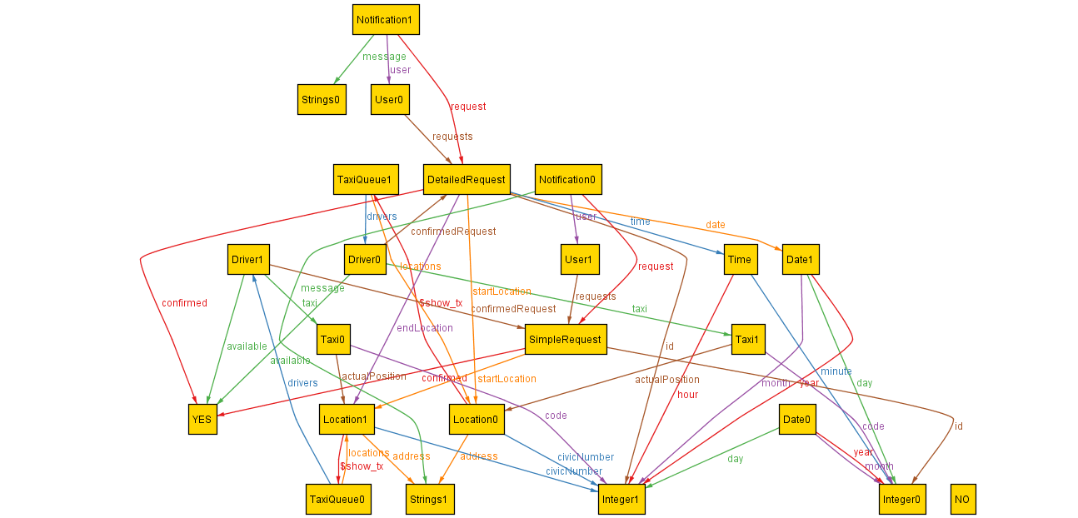
SECTION 4
EXAMPLE OF GENERATED WORLD:

Slide 30


Slide 31
Summary
Section 1: Introduction
Section 2: Architectural design
Section 3: Algorithm design
Section 4: User interface design
Section 5: Requirements traceability

Slide 32
Introduction
Section 1
Purpose
This software design specification is made with the purpose of outlining the software architecture and design of myTaxiService application system in detail.
The documents will provide to the developers an insight in meeting client's needs efficiently and effectively. Moreover, the document simplifies communication and understanding of the system by providing several views of the system design.

Slide 33
Introduction
Section 1
Scope
The software design document would demonstrate how the design will accomplish the functional and non-functional requirements defined in the RASD. The document will provide a framework to the programmers by describing the high level components and architecture, sub-systems, interfaces and algorithm design. This is achieved through the use of architectural patterns, sequence diagrams and user interfaces.

Slide 34
Architectural design
Section 2
The next chapter of the document describes architectural design of myTaxisystem: the high level components and their interactions, suitable architectural patterns, physical arrangement of components and design decisions applied to the whole system.

Slide 35
High level components
Section 2: Architectural design
AccessManager: This sub-system consists of all the components responsible of registration and login process. It authenticates users and drivers, allowing them to use their relative functionalities. It's also responsible for guest's registration.
Registration
Authentication

Slide 36
High level components
Section 2: Architectural design
User: This sub-system consists of all the components that implement the functions related to the user's operations such as requesting a taxi for a simple ride, making a reservation for a taxi and viewing the number of available taxis in his zone.
SimpleRequest
DetailedRequest
NumberOfTaxi
Notification

Slide 37
High level components
Section 2: Architectural design
Driver: This sub-system consists of all the components that implement the functions related to the driver's operations such as informing about their own availability and accepting an user's request.
BeAvailable
Conrmation

Slide 38
High level components
Section 2: Architectural design
DataManager: This is the major sub-system that is responsible for the security of sensible data. It communicates directly with the database providing several operations on it such as adding new users, adding new drivers, checking saved data with data given by the user during the login process.
AddData
QueryData

Slide 39
High level components
Section 2: Architectural design
Database: Essentially, it is formed by the databases and give all the functionalities through which operate directly on the database.
Drivers
Users
Requests
TaxiQueue

Slide 40
High level components
Section 2: Architectural design
Application: This is the major sub-system that is responsible of the logic of myTaxi app. In particular it manages all the requests done by the users forwarding them to the drivers according to the policy of forwarding.
ManageRequest
TaxiQueue

Slide 41
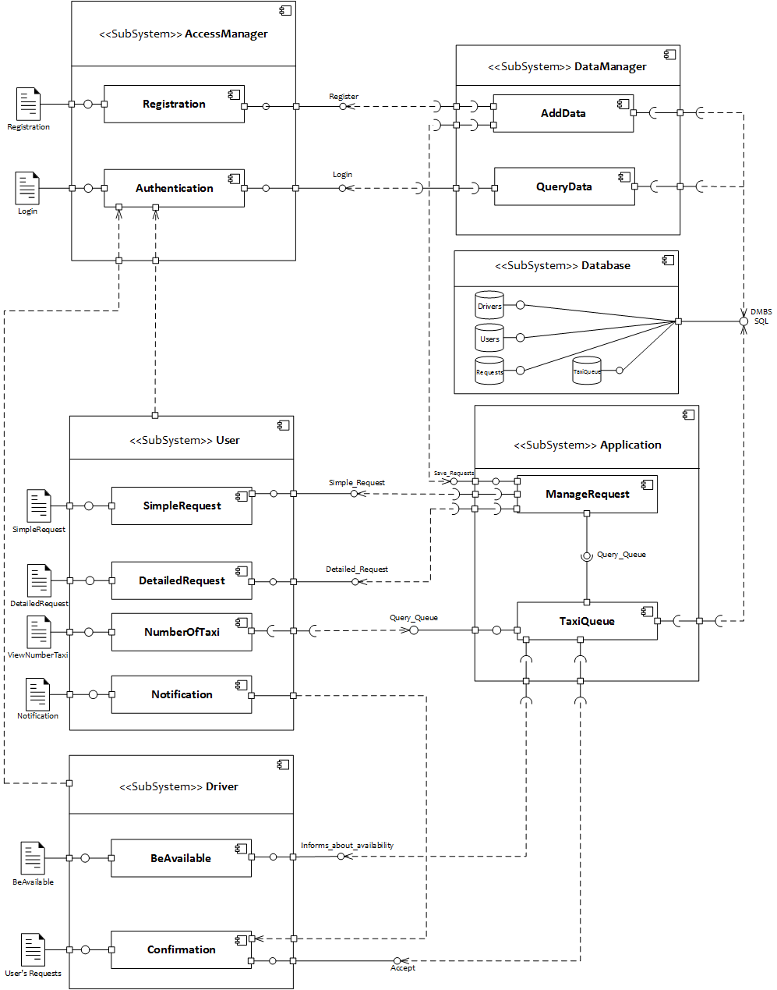
Component view
Section 2: Architectural design

Slide 42
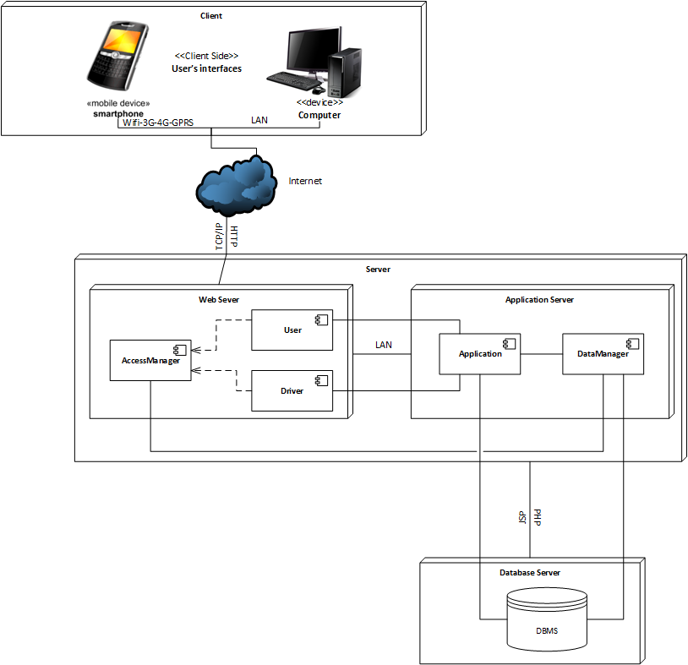
Deployment view
Section 2: Architectural design

Slide 43
Component interfaces
Section 2: Architectural design
AccessManager
Registration:Register - This interface allows a guest to register himself into the system by giving the mandatory information.
Authentication:Login - This is the interface that allows the users/drivers to log into the system. This will guide the user/driver to his relative home page.
DataManager
AddData: This component uses interfaces provided by other components in order to grant a major grade of security to the data tier interposing between the presentation tier and the data one.
QueryData: This component, like AddData, communicates with the data tier querying it in order to check user's information given by the user interface.

Slide 44
Component interfaces
Section 2: Architectural design
Database
The relevant interfaces given by this tier are the most common known methods through which it's possible to operate, manipulate and querying a database.
Driver
BeAvailable:Informs_About_Availability - This is the interface that allows a driver to inform the system about his current availability. It can be changed by both system and driver according to what is written in the RASD.
Confirmation:Accept - This is the interface through which a driver can accept an incoming user's request forwarded by the system.

Slide 45
Component interfaces
Section 2: Architectural design
User
SimpleRequest:Simple_Request - This is the interface that allows the users to ask for a taxi for a simple ride.
DetailedRequest:Detailed_Request - This is the interface that allows the users to reserve a taxi.
NumberOfTaxi - This component uses a required interface provided by the TaxiQueue in order to query it and know the number of available taxi in relation to the current position given by the GPS.
Notification: This is a component that only has a user's interface that depends on the conrmation of the user's own request.

Slide 46
Component interfaces
Section 2: Architectural design
Application
ManageRequest:Save_Request: This interface is given to the manager data component in order to retrieve information about requests and save them in the database.
ManageRequest:Taxi_Queue: This interface is the major central point of the application because it communicates with the other components whose tasks are to handle requests incoming from the users and forward them correctly to the drivers.
TaxiQueue:Query_Queue: This interface only allows to query the number of available taxis.
TaxiQueue: This component, with the required interfaces it needs, is the central point of our application because, as written before, it is responsible of the correct management of requests, users and drivers on whose the service provided by our application is based.

Slide 47
Selected architectural styles and patterns
Section 2: Architectural design
myTaxiService will be developed under two main architectural styles/patterns:
MVC architectural style
3 tier Client/Server Architecture

Slide 48
Selected architectural styles and patterns
Section 2: Architectural design
MVC Architecture Style (Model - View - Controller)
MVC separates presentation and interaction from the system data. The system is structured into three logical components that interact with each other.
1. The Model component that manages the system data and associated operations on that data.
2. The View component that denes and manages how the data is presented to the user.
3. The Controller component that manages user interaction and passes these interactions to the View and the Model.
We will use this MVC Style for myTaxi system because there are multiple ways to view and interact with the data. We have decided to use MVC architectural style to separate the application logic with the interface. The main advantage of this style is that it allows the data to change independently of its representation and vice versa.

Slide 49
Selected architectural styles and patterns
Section 2: Architectural design
Three-Tier Client Server Architecture
In a client-server architecture, the functionality of the system is organized into services, with each service delivered from a separate server. Clients are users of these services and access servers to make use of them. We will use this 3-Tier Client Server Architecture, because data in a shared database has to be accessed from a range of locations, in this way servers can be replicated. In particular, there are three tiers:
Data Tier
Application Tier
Client Tier

Slide 50
Selected architectural styles and patterns
Section 2: Architectural design
Data Tier
The data tier maintains the applications data such as Users' data, Drivers' data, Request data, TaxiQueue data and the SQL queries. It stores these data in a relational database management system (RDBMS). All the connections with the RDBMS are managed in this tier.
Application Tier
The application tier (web/application server) implements the business logic, controller logic and presentation logic to control the interaction between the application's clients and data. Business rules enforced by the business logic dictate how clients can't access application data directly and how applications process data.
Client Tier
The client tier is the application's user interface connecting data entry forms and client side applications. It displays data to the user. User interact directly with the application through user interface. The client tier interacts with the web/application server to make requests and to retrieve data from the database. It then displays to the user the data retrieved from the server.

Slide 51
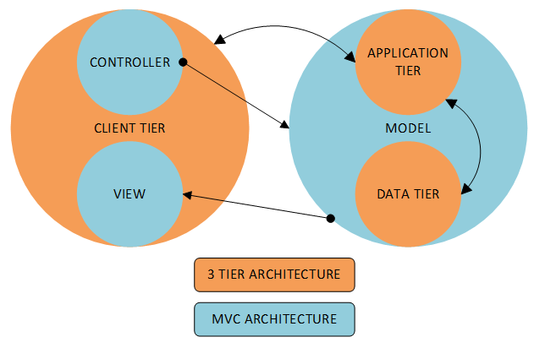
Section 2: Architectural design
In the picture it's shown how we have combined the two styles/patterns. On the presentation tier we have the view and the controller that invokes methods on the model in which there are the two other tiers. In particular, a change in the model come from the controller to the application tier which then forwards it to the data tier.

Slide 52
Other design decisions
Section 2: Architectural design
Object oriented software development methods
Improved software maintainability
Faster development
Lower cost development
Improved software development productivity
Higher quality software
Three-tier client server architecture
As more users access the system a three-tier solution is more scalable than the other solutions because you can add as many middle tiers as needed to ensure good performance.
Security is also the best in the three-tier architecture because the middle layer protects the database tier.

Slide 53
Other design decisions
Section 2: Architectural design
MVC Architectural Pattern
It should interact with other machines or users effectively.
For more efficient interaction, the system should have flexible interfaces.
MVC can be taken as for a popular and easy to handle web application development style that has the feature of separating the presentation and intermediate logics.
It's easy to code and provides well defined interfaces within each logic.

Slide 54
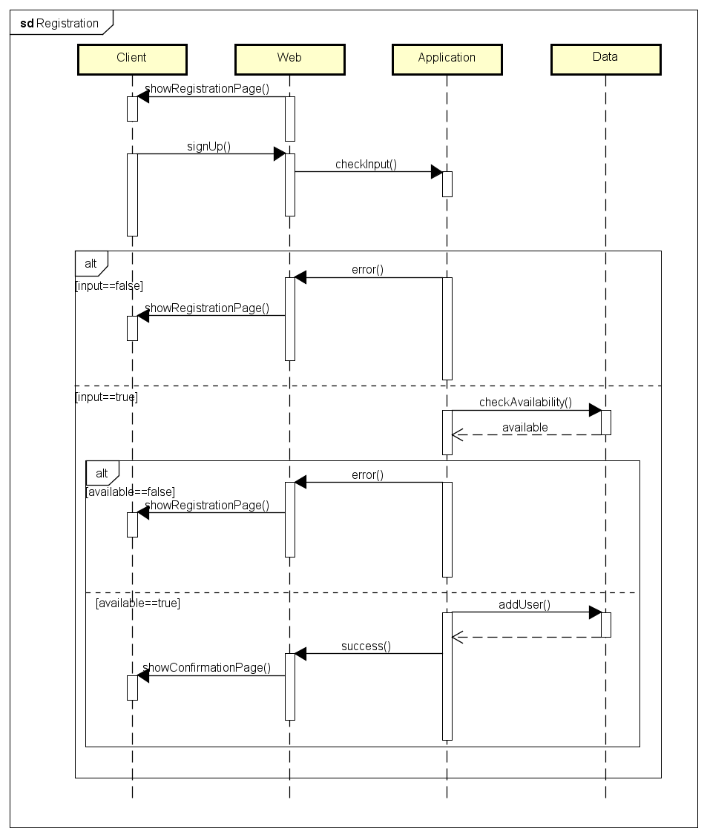
Runtime view
Section 3: Algorithm design
Registration
The algorithm takes in account the completeness, the correctness and the availability of the information inserted. After the guest submits the information the application checks if all the mandatory fields are filled and if the confirmation fields, such as password and email, correspond to the respective previous ones.
If one of the above doesn't apply, the application shows again the registration page to the guest. If they do, then it looks up into the database to verify that the username and email inserted are not already in use.If they don't, then the user is added to the database and is shown a confirmation page, inviting him to log in., otherwise the registration page is shown again.

Slide 55
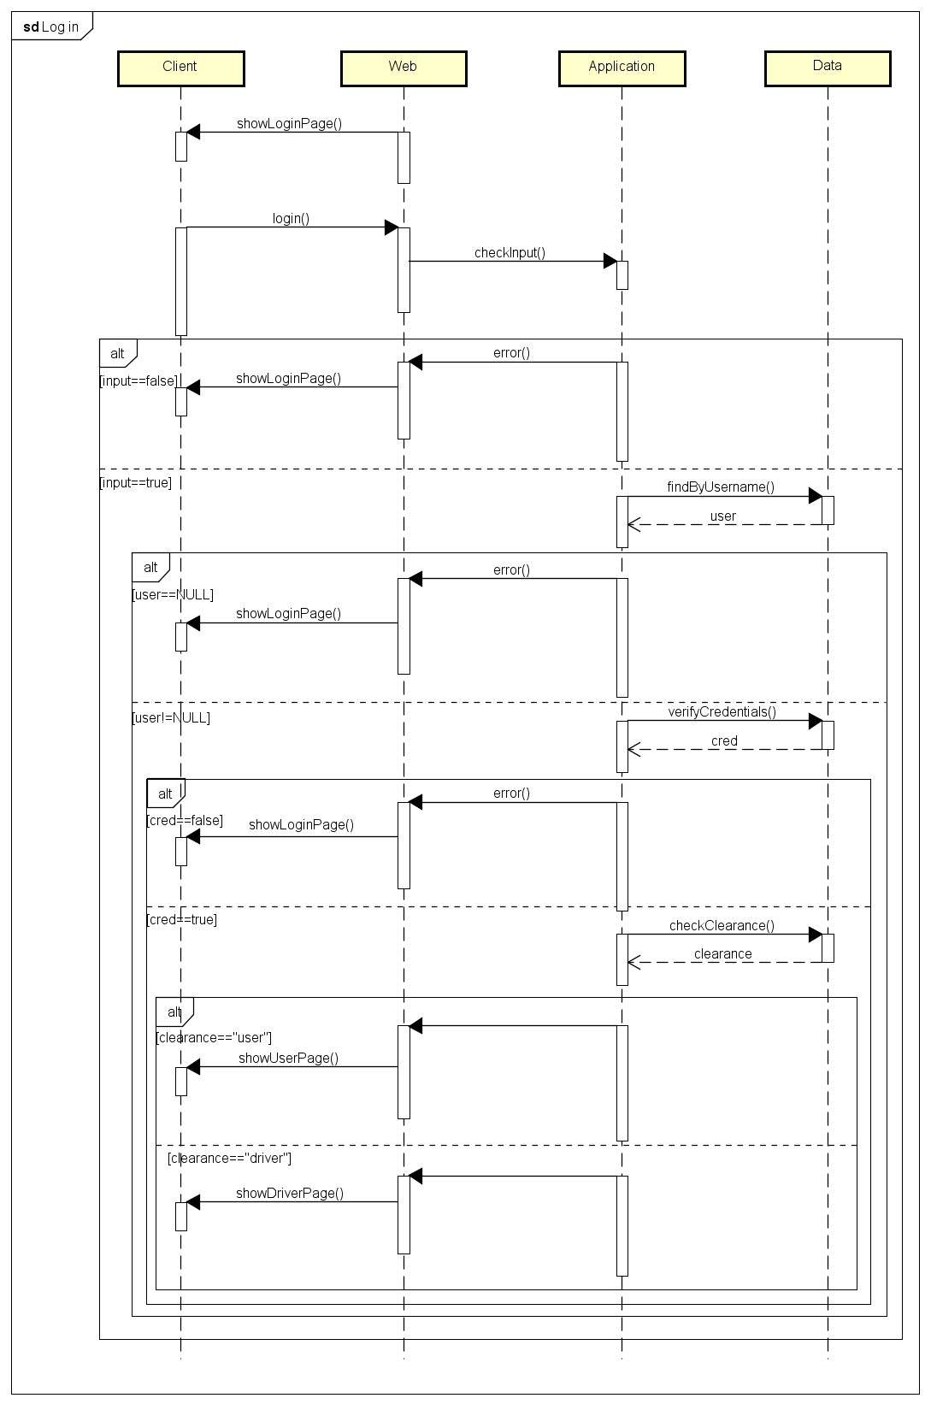
Runtime view
Section 3: Algorithm design
Log in
After the guest inputs his credentials, the application first checks if both fields are filled, then looks for the username in the database to see if it exists. If it does, it checks if the password matches too.
If all of these steps are verified, the guest is logged in and is shown his personal page, otherwise the application shows the login page again.
After the password verification, the application will check the privileges of the account that is about to log in and will consequently show the respective page, be it user's or driver's.

Slide 56
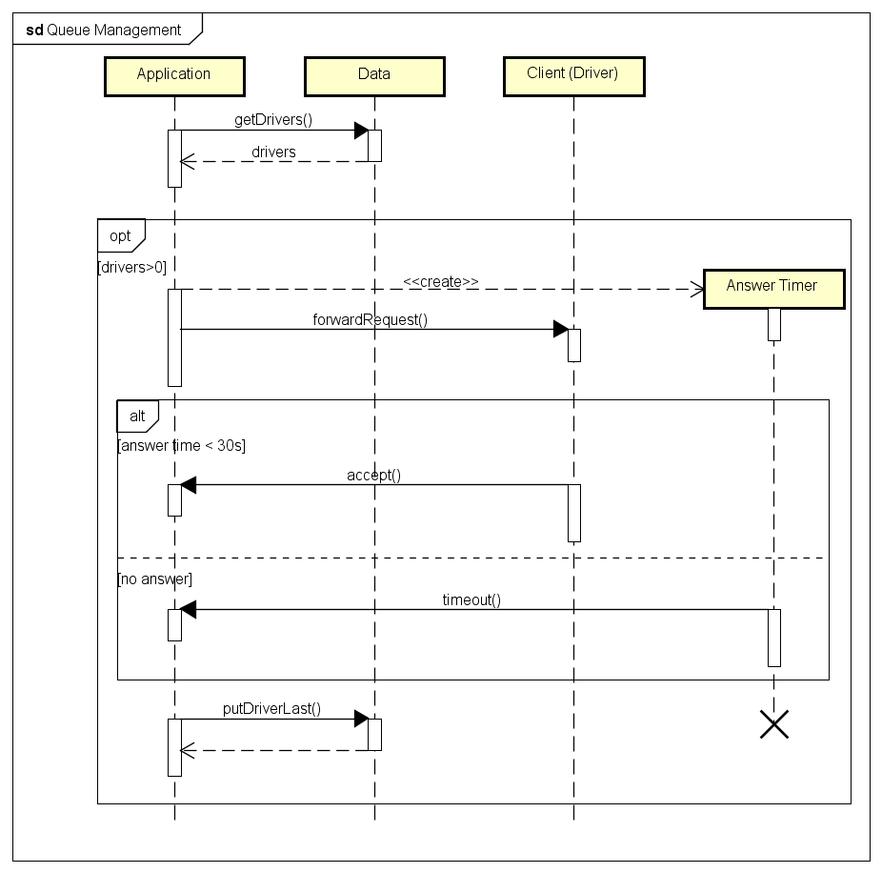
Runtime view
Section 3: Algorithm design
Queue management
This sequence diagram represents how the application manage to forward a request to a driver.
After a user makes a ride request, the application will then begin to allocate the first available taxi, otherwise if there's none it will just wait until one becomes available.
After forwarding the request to the taxi, the system will wait 30 seconds, if the driver answers the call he will be in charge for that request, or else the system forwards the request to the next available taxi in queue. In both cases the driver will be put at the end of the queue.

Slide 57
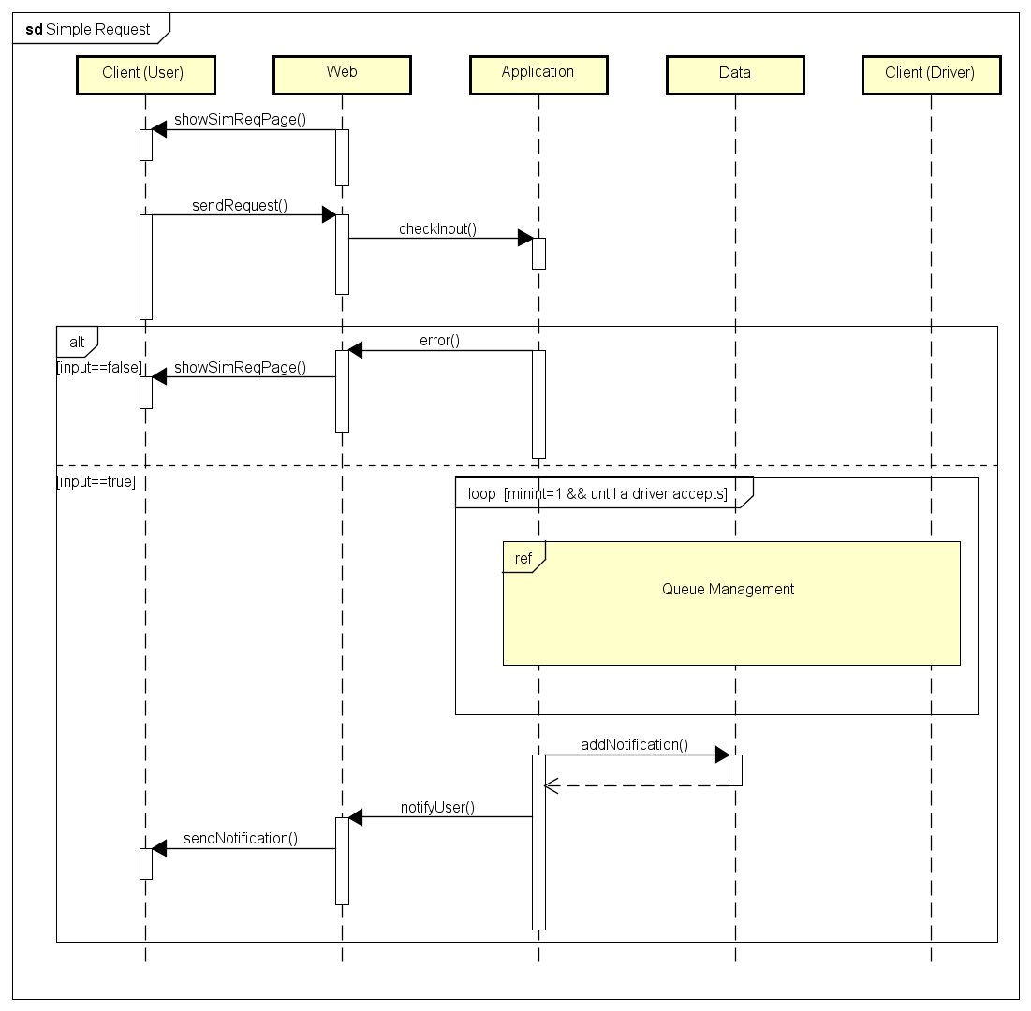
Runtime view
Section 3: Algorithm design
Simple request
After the user clicks on the Simple request button, he is shown the simple request page.
After he inserts the origin of his ride and press the Request button, the application will then begin to a taxi according to the Queue Management algorithm.
Once the taxi is allocated, the user is informed with a notification containing the code of the taxi and the waiting time.

Slide 58
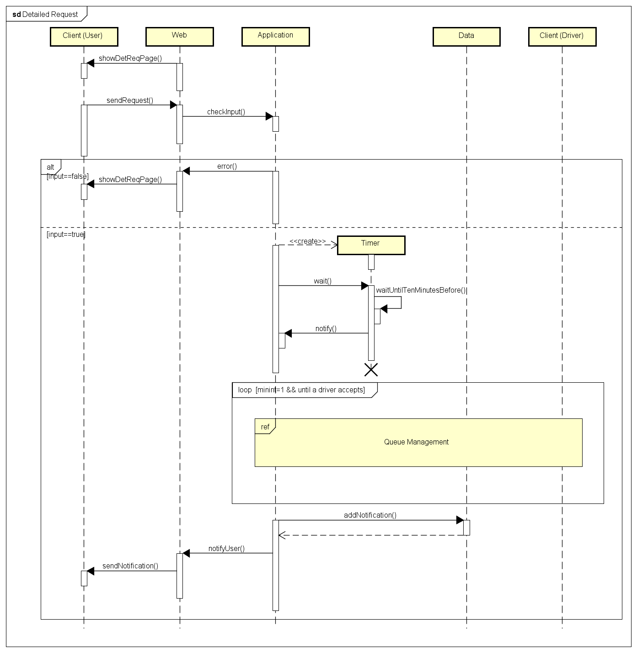
Runtime view
Section 3: Algorithm design
Detailed request
After the user click on the Detailed request button, he is shown the detailed request page.
The user must fill the form and click on the Request button. The application will then check if all the fields are filled and if time and date are formally correct. If that's so, the system will wait until 10 minutes before the ride and then begin to allocate a taxi for the request.
The following taxi allocation, queue management and notification works as the one in the simple request.

Slide 59
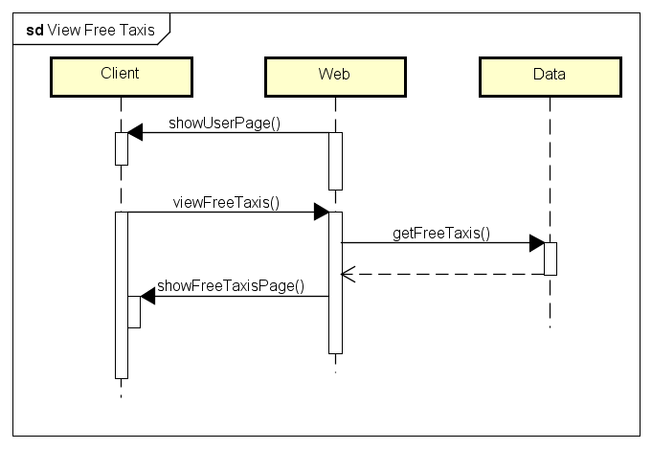
Runtime view
Section 3: Algorithm design
View free taxis
The users can look at the number of available taxis in their zone. By clicking on the View available taxis button, the application will query the database about it, and then return the result to a new page.

Slide 60
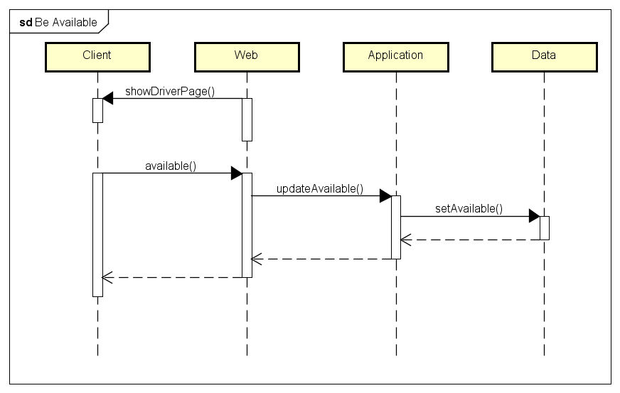
Runtime view
Section 3: Algorithm design
Be available
The drivers can use the switch on their personal page to toggle their own availability. After the button is switched, the application changes in the database the available field of the driver from false to true or vice versa.

Slide 61
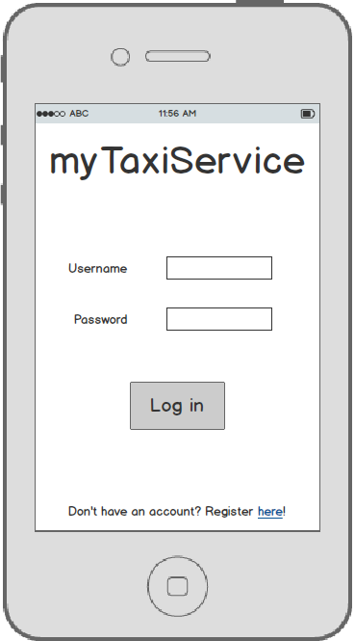
Log in page
Section 4: User interface design
This is the page that shows up when the app is opened. From here guests can log in or register themselves if they don't have an account yet.

Slide 62
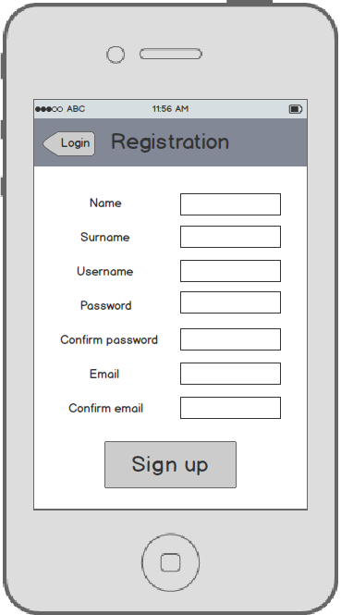
Registration page
Section 4: User interface design
Here guests can register themselves by filling all the mandatory fields (the ones shown).

Slide 63
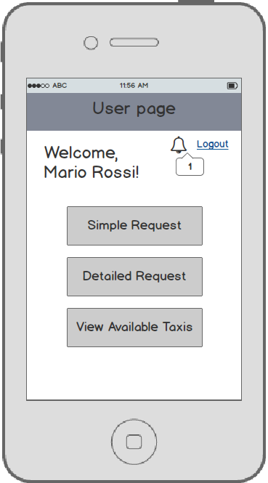
User page
Section 4: User interface design
After logging in, users see this page from which they can use all of their functionalities: request a ride, see available taxis in their area and read notifications.

Slide 64
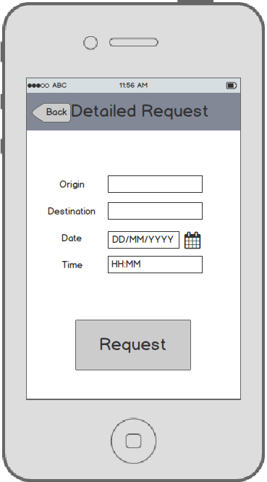
Detailed request
Section 4: User interface design
Users can make a detailed request by filling this form.

Slide 65
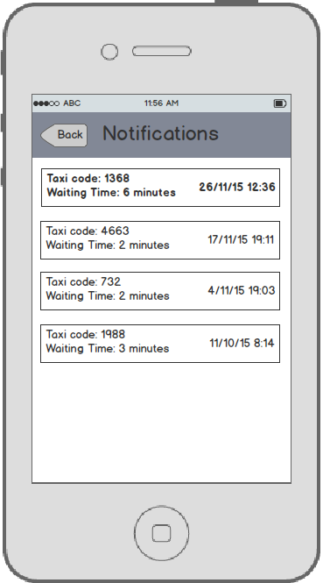
User notification page
Section 4: User interface design
Here users can see notifications about the requests they made. The new ones that hasn't been read yet are written in bold.

Slide 66
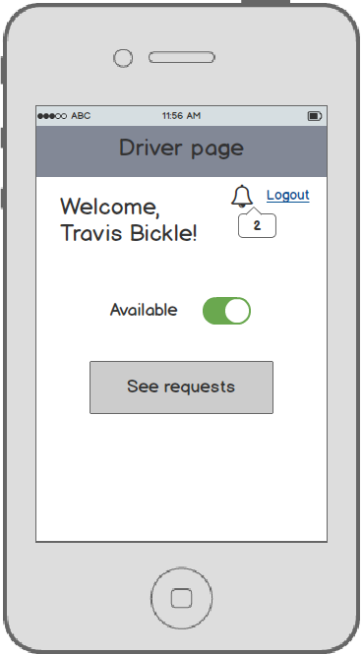
Driver page
Section 4: User interface design
This is the page that driver see after they log in. They can set themselves as
available and see incoming requests.

Slide 67
Guests requirements
Section 5: Requirements traceability
[G1] Register themselves into the system
Guests can only see the login, registration and confirmation pages, because when they login they are automatically promoted to users or drivers
The filling of the mandatory fields of the form is guaranteed by the algorithm, who discards also if they confirmation fields don't match or if the username or email are already in use.
[G2] Log into the system
This too is guaranteed by the algorithm, which checks if the fields are filled, then if the username exists and in the end checks if the username matches the password.

Slide 68
Users requirements
Section 5: Requirements traceability
[G3] See number of taxis of the zone he's in
The application is able to guarantee this through the View free taxis function, which queries the database for the information.
[G4] Make request for a simple ride
The algorithm for this function checks if the origin field is empty. If it is, the request can not be fulfilled.
[G5] Make request for a detailed ride
As before, the algorithm makes sure that the input is not empty and formally correct.

Slide 69
Drivers requirements
Section 5: Requirements traceability
[G6] Set themselves as available
The driver has this function in the personal page and so he can toggles his availability.
[G7] Read and accept requests
In his personal page the driver can access to the page where he can read the incoming requests and eventually accept them. The application then proceeds to allocate the driver to the ride and set himself as unavailable.

Slide 70
System requirements
Section 5: Requirements traceability
[G8] Notify passengers after the confirmation of a simple request
The algorithm of the simple ride request takes care of this by notifying the user as soon as the taxi is allocated.
[G9] Notify passengers 10 minutes before the ride reserved through a detailed request
The algorithm waits until 10 minutes before the ride and then begins to look for a taxi to allocate and notifying the user as soon as it's done.

Slide 71
System requirements
Section 5: Requirements traceability
[G10] Forward requests to the first taxi in queue
The application, after a ride request, always forwards it to the first taxi in queue of the user's zone. Then, when a driver is allocated, the application puts him in the last position and sets him as unavailable.
[G11] After 30 seconds, forward the request to the second taxi in queue and put the first at the end
A timer ensures that the driver answers a request within 30 seconds, otherwise he is set as unavailable and put in the last position. The latter will cause the queue to shift by a position and the request will then be forwarded to the driver who is now in the first one.

Slide 72


Slide 73
Summary
Section 1: Introduction
Section 2: Integration strategy
Section 3: Integration tests
Section 4: Stubs and data test required

Slide 74
Introduction
Section 1
Purpose and scope
This document describes how to test the integration of the components of the system. Its purpose is to test if the components are correctly integrated between each other, as described in the Design Document.
The scope of the document is to check that the application functionalities are correctly implemented, starting from the login process, to the ride requests to be made by the users and the correct handling of all this through the application logic.

Slide 75
Entry criteria
Section 2: Integration strategy
Before starting the integration testing of the subsystems, we recommend to perform a unit test on the Application sub-system in order to check the algorithm correctness, the functional specifications and the structural coverage. This is the major class that contains the logic of myTaxiService. In this class will be implemented, according to the document design already provided, the algorithm of management of the queues of taxis and the algorithm responsible for the forwarding of the requests arrived from the user to the taxi drivers and that's why it's important to perform a unit test on this class before proceeding to the integration test.
The documentation about what is needed to perform this kind of test is in the fourth section of this presentation.

Slide 76
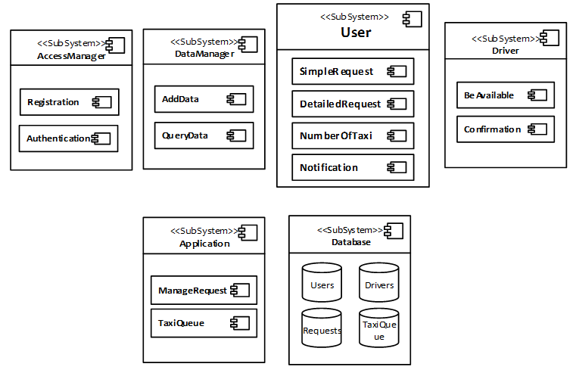
Elements to be integrated
Section 2: Integration strategy
The items to be tested consists of the integration of all the subsystem developed that form myTaxiService.

Slide 77
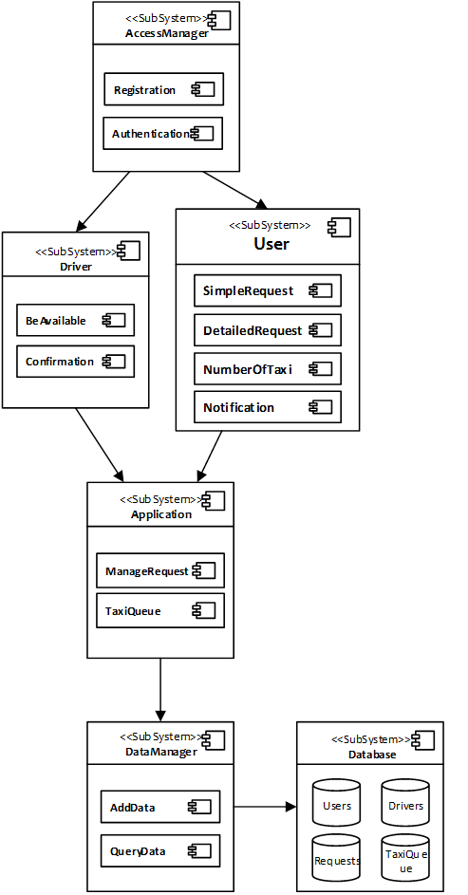
Integration testing strategy
Section 2: Integration strategy
For testing, we choose the top-down approach. In this approach testing is conducted from the high level interfaces to the core of our application. It's advantageous because the major flaws occur toward the top of the program. It's also a way to simplify the readability of the results of the test case because once the I/O functions are added, representation of test cases is easier. Due to these considerations, in the picture is shown through the arrows the order of integrations between the subsystems.

Slide 78
Integration test I1
Section 3: Integration tests
Integration Test Identifier | I1T1
Test item(s) | This test procedure verifies the correct integration between AccessManager and the User and Driver components.
Purpose | The test must check if the AccessManager can correctly handle users' input.
Preconditions | A Database and a DataManager stub must be created to simulate the login process.
Procedure Steps | Some input tries will be performed, including the login of a User and a Driver. If the components are correctly integrated, the AccessManager should be able to differentiate between the two types of login and show the correct personal page.

Slide 79
Integration test I2
Section 3: Integration tests
Integration Test Identifier | I2T1
Test item(s) | This test procedure verifies the correct integration between the User and the Application components.
Purpose | The test must check if the User component can correctly dispatch users' requests.
Preconditions | I1T1 must have been already correctly executed.
Procedure Steps | The two main functionalities of this component are tested, that are SimpleRequest and DetailedRequest. If the components are correctly integrated the Application should correctly receive the requests from the User and will then proceed to manage them.

Slide 80
Integration test I2
Section 3: Integration tests
Integration Test Identifier | I2T2
Test item(s) | This test procedure verifies the correct integration between the Driver and the Application components.
Purpose | The test must check if the Driver component can correctly receive users' requests and reply to them.
Preconditions | I2T1 must have been already correctly executed. The stubs described in the 4.3 section must have been created.
Procedure Steps | At first it must check that the Driver, by setting himself as available, is correctly inserted in a queue. Then a simulated request from the stub is sent to the Driver which then should act properly, either if he answers the request or not.

Slide 81
Integration test I3
Section 3: Integration tests
Integration Test Identifier | I3T1
Test item(s) | This test procedure verifies the correct integration between the Application and the DataManager.
Purpose | The test must check if the Application component can correctly make query and modification requests of the Database through the DataManager.
Preconditions | A Database stub is needed.
Procedure Steps | The Application should try dispatching the query and add calls to the DataManager. Some examples of these calls can be the query for the first available driver in a queue and the modification of the order of a taxi queue after the Driver's answer to a request.

Slide 82
Integration test I4
Section 3: Integration tests
Integration Test Identifier | I4T1
Test item(s) | This test procedure verifies the correct integration between the DataManager and the Database components.
Purpose | The test must check if the DataManager can correctly query and modify the Database.
Preconditions | I3T1 must have been already correctly executed.
Procedure Steps | The DataManager should be able to receive query and modification requests from the logic (Application) of the system, correctly execute them and eventually return the desired data.

Slide 83
Stubs and data test required
Section 4
At the first step of our integration, a stub that simulates the database response correlated to a logging or registering action is required.
A stub that simulate operations on a database is also needed.
At the second step of the integration test different stubs are required:
A stub for drivers which by clicking on be_available gains the right to enter in a queue list.
A stub that simulate a pending request.
A stub that simulate the timing out of the response time with the relative consequences.
By integrating the remaining components there are no stubs to add.

Slide 85
Purpose
In the first part of this document we are going to show through two different procedures, the size of our app and the estimated cost.
In the second part instead we are going to show the project tasks and their relative division during the project.
In the last part we will show our risk project management.
How did we do this?
Functional Points
COCOMO II
Task chart diagram

Slide 86
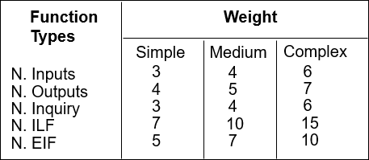
Section 1
Functional Points
A function point is a "unit of measurement" to express the amount of business functionality an information system provides to a user. Function points measure software size. The table below shows the weights values that we have used to calculate the FP value.
We have used this table to find the functional points of our app.

Slide 87
Section 1
In particular:
We have taken into consideration these aspects:
Internal Logic Files (ILFs)
External Logic Files (EIFs)
External Inputs (EIs)
External Inquiries (EIQs)
External Outputs (Eos)
It’s a user identifiable group of logically related data that resides entirely within the application.
It’s a user identifiable group of logically related data that is used for reference purposes only.
It is an elementary process in which data crosses the boundary from outside to inside.
It‘s an elementary process with both input and output components that result in data retrieval from one or more internal logical files and external interface files.
It is an elementary process in which derived data passes across the boundary from inside to outside.

Slide 88
Aspect | Total cost | Description
Internal Logic File | 56 | The application stores information about: Users, Drivers, Requests, TaxiQueue, Taxis and Locations.
External Logic File | 10 | The application has to manage the position of each taxis from an external service based on GPS locations
External Inputs | 26 | The application has to manage all the interactions between users and driver.
External Inquiries | 13 | The application allows a user to view the number of taxi available in his zone according to his phone GPS location and the application allows a driver to view the pending user’s requests in order to confirm them.
External Outputs | 0 | There is no external output
TOTAL | 105 | we can hypostasize the size of the project in terms of lines of code. LOC = 105 * 46 = 4830 Lines Of Code.

Slide 89
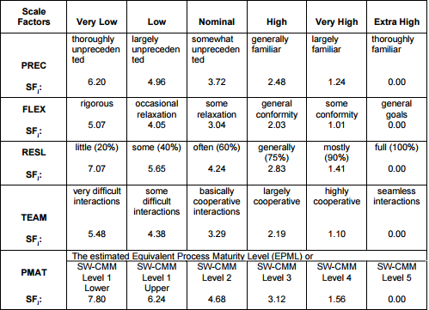
Section 1
COCOMO II
COnstructive COst MOdel II is a model that allows one to estimate the cost, effort, and schedule when planning a new software development activity. .
We have used this table for the first part and all the other table relative to the different aspects found in the manual of this model.

Slide 90
In particular:
Aspect | Incidence | Value | Description
PRECEDENTNESS | Very low | 6,20 | It reflects the previous experience in past project like this. For us, this kind of project is the first in our life we are doing and that’s why this value will be very low.
DEVELOPMENT FLEXIBILITY | Very high | 1,01 | It reflects the degree of flexibility in the development process. The professor left us a large space of flexibility without forcing us with too much details, that’s why this value is going to be very high.
RISK RESOLUTION | Very high | 1,41 | According to our project risk management.
TEAM COHESION | Very high | 1,10 | It reflects how well the development team know each other and work together. At the beginning of the project we didn’t know each other and both of us did not know how the other worked. Although this aspect, we hadn’t any problems on work’s organization and division of tasks. Due to these considerations, this value will be very high.
PROCESS MATURITY | High | 3,12 | There are two ways of rating Process Maturity. We have chosen the second that s organized around the 18 Key Process Areas (KPAs) in the SEI Capability Maturity Model. We can consider this value as high.
TOTAL |  | 12,84

Slide 91
Driver factor | Incidence | value
Required software reliability | Very high | 1.26
Database size | High | 1.00
Product complexity | Nominal | 1.00
Required reusability | High | 1.07
Documentation match to life-cycle needs | Nominal | 1.00
Execution time constraint | Very low | n/a
Main storage constraint | Very low | n/a
Platform volatility | Low | 0.87
Analyst capability | Very high | 0.71
Personnel continuity | Very low | 1.29
Application experience | Low | 1.10
Platform experience | - | -
Programmer capability | - | -
Language and tool experience | - | -
TOTAL (PRODUCT) |  | 1.18

Slide 92
Section 1
Effort estimation
The final equation gives us the effort estimation measured in Person-Months (PM)
Effort = A * EAF * KSLOCE
The values of A, B, C, and D in the COCOMO II.2000 calibration are:
A = 2.94 B = 0.91
C = 3.67 D = 0.28
EAF is the product of all the cost drivers that is equal to: 1.18
KSLOC represents the estimated lines of code obtained from the FP analysis: 4830
E is the exponent derived from the Scale Drivers with the equation below:
B+0.01* sum{i} SF[i] = 0.91 + 0.01 * 12.84 = 1.0384
With all of these parameters we can calculate the final effort:
Effort = 2.94*1.18*4.830^{1.0384} = 17.8008 PM

Slide 93
Section 1
Shedule estimation
We are going to use this formula to compute the estimated duration:
Duration := 3.67 * Effort^{F}
Where F = 0.28 + 0.2 * (E-B) = 0.28 + 0.2 * (1.0384-0.91) = 0.3057
So → Duration = 3.67 * 17.8008^{0.3057} = 8.84 → 9
The duration estimated by these computations is not similar to how the reality is. It is also truth that in our project we had just to do the documentation. Probably if we were to do also the implementation and development of the entire application, the duration of the global project could be about 9 months.
P = Effort/ Duration = 17.8008/9 = 1.98 → 2

Slide 94
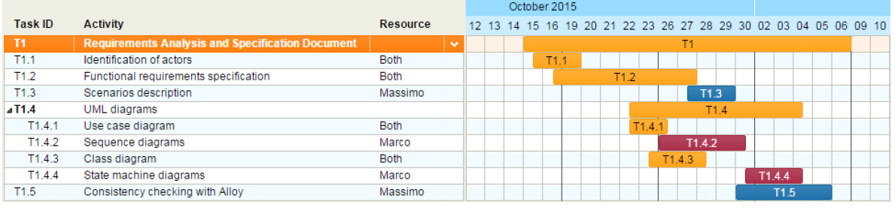
Section 2
Task chart diagram
On the right part of the diagram we can find a list of task for the Requirements Analysis and Specification Document, on the left it’s shown the «work in progress» during the project period.

Slide 95
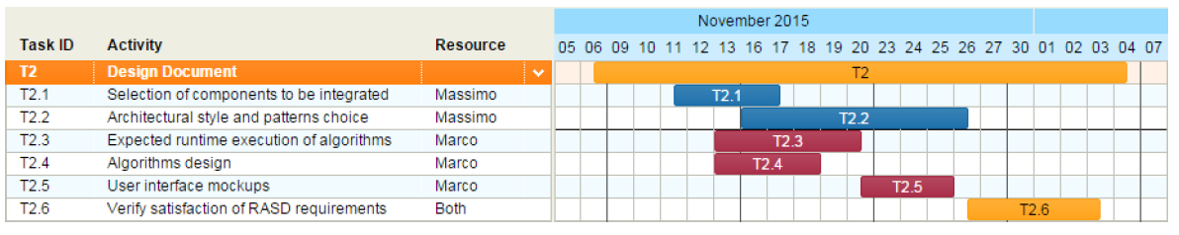
Section 2
Task chart diagram
On the right part of the diagram we can find a list of task for the Design Document, on the left it’s shown the «work in progress» during the project period.

Slide 96
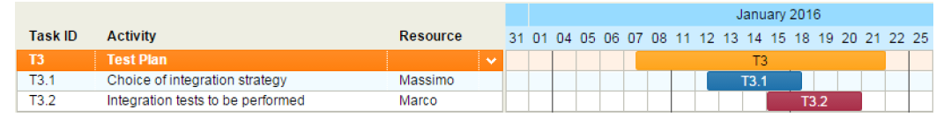
Section 2
Task chart diagram
On the right part of the diagram we can find a list of task for the Test Plan, on the left it’s shown the «work in progress» during the project period.

Slide 97
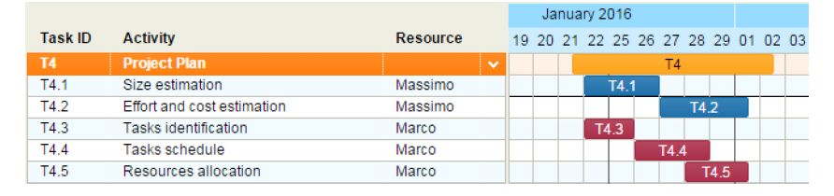
Section 2
Task chart diagram
On the right part of the diagram we can find a list of task for the Project Plan, on the left it’s shown the «work in progress» during the project period.

Slide 98
Section 3
Project risk management
Risk | Probability | Effect | Strategy
The database used in the system cannot process and manage all the transactions per second as expected | Moderate. It depends on how much the application will be used in the market. | Serious. The system can go down and cannot process some requests from the users | Alert the customer when the capacity of database is running out fast. Two alternatives: Delete the oldest data. Adding a new database to the system.
The server has a data overload. | Low. This risk has a pre-strategy used to manage it because tests about stress were done. | Catastrophic. If this case occur, the entire system goes down not only by processing the last requests but it is also impossible to access into the system while the system is still down. | This can happen principally during the rush hour. It is useful to increase the server capability during these hours.

Slide 99
Risk | Probability | Effect | Strategy
A user’s request considered by him as sent, it is actually never been sent due to a network error. | Low. This can happen only if people are in a place with little cellular coverage. | Serious. A user believes he has sent a request, but in reality, it is not true. | Force a minimum cellular coverage to all the users for using correctly the application.
Market risk. This is meant as the possibility to not have an expected number of downloads due to the age of the population in relation to those who use the service. The teenager and the part of the population that is young, use much more the railways services than the taxi. | Moderate. This risk can be taken into consideration based on what the city is smart. Integrate a service like this in a city whose population is old would make little sense. | Moderate. Probably the money coverage spent on the project will has much time to be regained. | It is useful to study accurately the target population before staring to develop the app. It is a good thing make a survey by which obtain the habits of the citizens.

Slide 100
Risk | Probability | Effect | Strategy
People risks. This is associated with the availability, skill level, and retention of the people on the development team. Probably it could be useful to have a programmer and a designer in our team. | High. | Low. Probably the absence of these two figures mean a low palatability level of the application in terms of design. The functional use of the application is anyway guaranteed. | The customer can inform about these two figures to include in the project team only during the development part according of course to the estimated cost.

